Slide 1
C++ Programming:
Problem Solving and Programming
Chapter 2
Basic elements of C++

Slide 2
Objectives
In this chapter you will:
Become familiar with the basic components of a C++ program, including functions, special symbols, and identifiers
Explore simple data types and examine the string data type
Discover how to use arithmetic operators

Slide 3
Objectives
Examine how a program evaluates arithmetic expressions
Learn what an assignment statement is and what it does
Discover how to input data into memory using input statements
Become familiar with the use of increment and decrement operators

Slide 4
Objectives
Examine ways to output results using output statements
Learn how to use preprocessor directives and why they are necessary
Explore how to properly structure a program, including using comments
Learn how to write a C++ program

Slide 5
2.1 C++ Program Structure
#include <iostream>
using namespace std;
int main(void)
{
int x, y, total;
x = 10;
y = 20;
total = x + y;
cout<<“Total:”<<total;
return 0;
}
  Basic structure:
  #include <iostream>
  using namespace std;
  int main()
  {
  Declaration statements
  Executable statements
  }

Slide 6
2.2 Preprocessor Directives
C++ has a collection of library files
Every library file has a name and is referred as header file
Syntax to include a header file in the program
#include <header file name>
Example: #include <iostream>

Slide 7
#include Directive
Usually used at top of the program to insert the contents of header file into the program
#include <iostream>
- the codes/functions like cin and cout are found in the iostream header file. They are made
available for use in the program
Do NOT place a semicolon at the end of #include line

Slide 8
Using cin and cout in a Program and namespace
cin and cout are declared in the header file iostream, but within a namespace called std
namespace std is a declarative region that provides a scope for those standard functions
To use cin and cout in a program, use the following two statements:
#include <iostream>
using namespace std;

Slide 9
2.3 Comments
It is helpful to place some comments in the code to help the reader to understand the meaning of the code
2 types of comments:
- Block comment ( /* and */ )
- Line comment ( // )

Slide 10
Block Comment
/* This is a block comment that
covers two lines. */
/*
This is a very common style to put the opening token on a line by itself, followed by the documentation and then the closing token on a separate line. Some
programmers also like to put asterisks at the
beginning of each line to clearly mark the comment.
*/

Slide 11
Line Comment
// This is a whole line comment.
a = 5; // This is a partial line comment.

Slide 12
Example
Add block comment and line comment into the
following program:
/* Author: Michael Tan
Date written: 20 Oct 2019
Purpose: Program is written to find total of 2 numbers */
#include <iostream>
using namespace std;
int main ( )
{ // Declare variables
int num1= 5, num2 = 10, total;
total = num1 + num2; // find total of 2 numbers
cout << “Total = “ << total; // output result
return 0;
}

Slide 13
2.4 Identifier
Is a programmer-defined name for program elements such as variables, functions, etc.
Rules for identifiers:
  Must consist only alphabets, digits or underscores
  First alphabet must be alphabet or underscore
  Cannot be same with keywords / reserved words

Slide 14
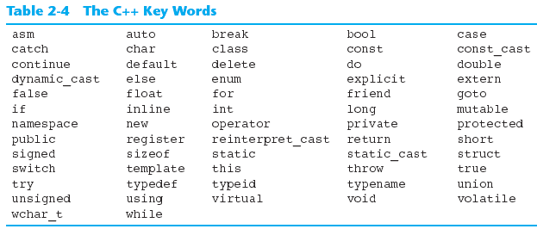
C++ Key Words
You cannot use any of the C++ key words as an identifier. These words have reserved / pre-defined meaning. They are in lower case.

Slide 15
Valid and Invalid Identifiers
IDENTIFIER | VALID? | REASON IF INVALID
totalSales | Yes
total_Sales | Yes
total.Sales | No | Cannot contain ‘.’
4thQtrSales | No | Cannot begin with digit
totalSale$ | No | Illegal symbol $

Slide 16
Remember!!
Use meaningful / descriptive names for identifiers.
E.g. to store the future value of an investment:
  f (too short)
  fv (too short)
  future_value_of_an_investment (too long)
  future_value (OK)

Slide 17
2.5 Data Type
A type defines a set of values and a set of operations that can be applied to those values.

Slide 18
Data Type : Examples
Data Type | Description | Example
char | Single character (value is enclosed within a pair of single-quote). | ‘A’, ‘a’, ‘8’, ‘?’
int | Integer number. | 0, 123, -456
bool | Contain true or false value (In memory, 1 represents true, 0 represents false) | true, false
float | Floating-point number. | 12.34
double | Double-precision floating-point number (more accuracy). | 3.1415926535898

Slide 19
2.6 Declare / Define variables
Data Type
Identifier / variable name
Memory:
?
gender
char gender;
int year;
float price;
double pi;
?
year
?
price
?
pi

Slide 20
Assign value to variables:
Memory:
char gender;
int year;
float price;
double pi;
gender = 'F';
year = 2008;
price = 25.99;
pi = 3.1415926235898;
‘F’
Assign (store) value to variables
gender
2008
year
25.99
price
3.1415926235898
pi
Remark: Assign a value that is matched with the declared data type. Type mismatch may result in error.

Slide 21
Initialization of variables:
Initialization: assign value to variables while creating them.
Memory:
‘F’
gender
char gender = 'F';
int year = 2008;
float price = 25.99;
double pi = 3.1415926235898;
2008
year
25.99
price
Remark: Uninitialized variable invites “garbage value” (not meaningful) . Thus it is good to always initialize the variable before you use it later.
3.1415926235898
pi

Slide 22
Data Type - String
String is a sequence of characters
Can be declared as
  C-string
  String class
Note: String will be discussed further in another chapter

Slide 23
Data Type – C-String
Array of characters
Example:
  char name[21];
  Indicates the string contains 20 characters in length plus one terminating null character (\0)
Note: To read string
  cin >> name; // read a single word string
  cin.getline(name, 21); // read multiple words string

Slide 24
Data Type – String Class
#include <string>
using namespace std;
string day = “Tuesday”;
string date = “1 January, 2013”;
char space = ‘ ’;
cout << day << space << date;
Include string library
Declare and initialize a string variable
You may replace this with string space= “ ”;

Slide 25
Data Type – String Class
string name=“”, mood=“”;
cout << “Enter your name:”;
cin >> name;
cout << “How is your mood?”;
getline(cin, mood);
Can only read ONE word
Will read the entire line of input into mood variable

Slide 26
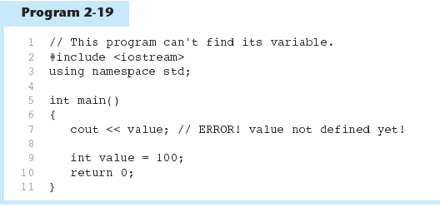
Scope
The part of the program in which the variable can be accessed
A variable cannot be used before it is declared
Example:

Slide 27
Allocating Memory
Variable: memory location whose content can be changed during program execution
Named Constant: memory location whose content can’t be changed during program execution

Slide 28
2.7 Declare / Define Constants
Named Constant
Syntax: const <data type> <identifier> = value;
const is a reserved word
Data value MUST be initialized during declaration and can’t be changed (read-only) during program execution.
Examples:
const int THIS_YEAR = 2019;
const double PI = 3.14159;
const char HASH = ‘#’;
const char HELLO[] = “Hello World”;

Slide 29
2.7 Declare / Define Constants
Defined Constant
A defined constant is a name that replaces the constant name in the program body with the expression associated with that constant name.
The preprocessor command #define is used.
Examples:
#define PI 3.14159
#define YEAR 2019
#define PET_NAME “Doggy”
#define GOOD_GRADE ‘A’

Slide 30
2.7 Declare / Define Constants
// EXAMPLE of Defined Constant
#include <iostream>
using namespace std;
#define GRAMS_PER_KG 1000
int main() {
double grams, kgs;
cout << “Enter weight in KG : ”;
cin >> kgs;
grams = kgs * GRAMS_PER_KG;
cout << kgs << “KG is equal to ” << grams << “grams” << endl;
return 0;
}

Slide 31
2.8 Program Statements
A statement causes the computer to carry out some action.
Statements consists of:
  Expression statements
  Compound statements
  Control statements

Slide 32
Expression statements
Consists of an expression followed by a semicolon.
Examples:
a = b + c;
cout<<“a = “<<a;

Slide 33
Compound statements
Consists of several individual statements enclosed within a pair of braces { } .
Example:
{
pi = 3.141593;
area = pi * radius * radius;
}

Slide 34
Control statements
Used to create special program features, such as logical tests, loops and branches.
Example:
while (count <= n)
{
cout << “x = ”;
cin >> x;
if (x > 10)
sum += x;
++count;
}

Slide 35
2.9 Mixed Type Conversion
To evaluate the expressions involve data of different type, one of the type must be converted
  E.g. integer * float
In an assignment expression, the final expression value must have the same data type as the left operand, which receives the value.
There are 2 types of conversion:
  Implicit type conversion
  Explicit type conversion

Slide 36
Implicit Type Conversion
C++ automatically converts one type to another, according to the promotion order (conversion rank).
E.g., int a;
double x, b;
x = a + b;
The conversion is only temporary; the converted value is back in its original data type as soon as the expression is finished.

Slide 37
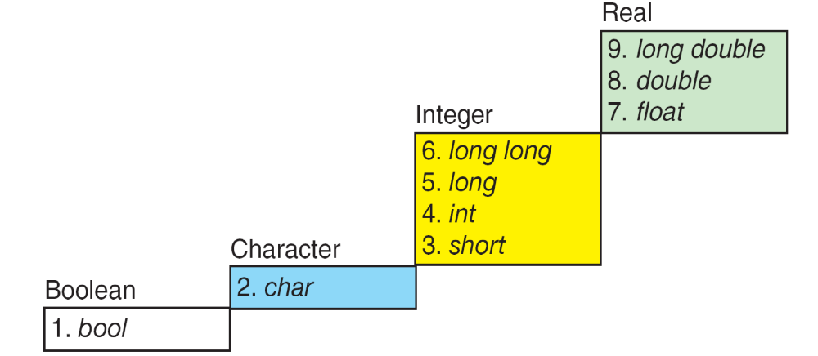
Implicit Type Conversion
High
Low
FIGURE 4-11 Conversion Rank

Slide 38
Implicit Type Conversion
Example:
Expression | Intermediate Type
char + float | float
int - long | long
int * double | double
float / long double | long double
(short + long) / float | long then float

Slide 39
Implicit Type Conversion
Example 1:
char c = ‘A’;
int i = 1234;
i = c; // value of i is 65
Example 2:
char c = ‘A’;
int k = 65;
c = k + 1; // value of c is ‘B’
Example 3:
char c = ‘A’;
int i = 3650;
short s = 78;
long double d = 3458.0004;
cout << i * s; // result is in int
cout << d * c; // result is in long double

Slide 40
Explicit Type Conversion
Cast operator is used to convert data type from one type to another type
Specify new type in parenthesis before the value that need to be converted
  (double) number;
E.g.
int no1, no2;
double X = (double)(no1 / no2);
double X = (double)no1 / no2;
double X = static_cast<double>(no1)/no2;

Slide 41
Question
State the output of the following
int num1 = 9, num2 = 2;
double x = num1 / num2;
double y = static_cast<double>(num1/num2);
int z = num1 / (double)num2;

